Slide 1
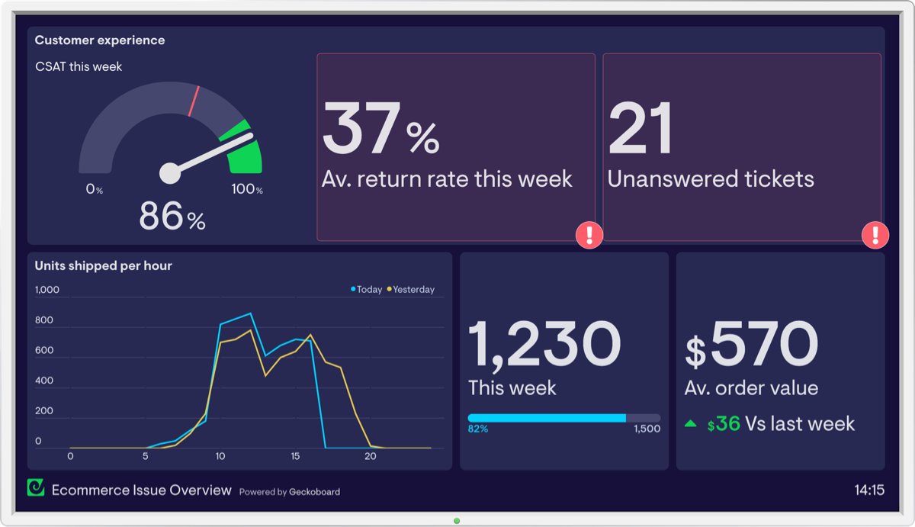


mySalesCloud.in
Sales Order Automation Using Android App
Mobile Solution
Real-time Data
Order Tracking
Bonrix Software Systems
Ahmedabad, Gujarat, India

Slide 2
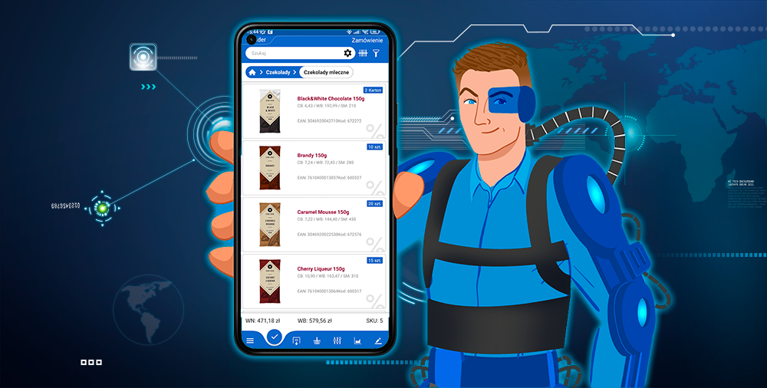




Company Overview
Bonrix Software Systems
Location
Ahmedabad, Gujarat, India
Business Focus
Mission
Sales automation • Mobile solutions • Cloud platforms
Providing innovative and efficient automation solutions for businesses
Contact Information
info@bonrix.net
📞 +91-9426045500, 9429045500
Experience
Technology
Leading provider since 2005
Android & cloud solutions
Clients
Support
500+ businesses across India
24/7 technical assistance

Slide 3
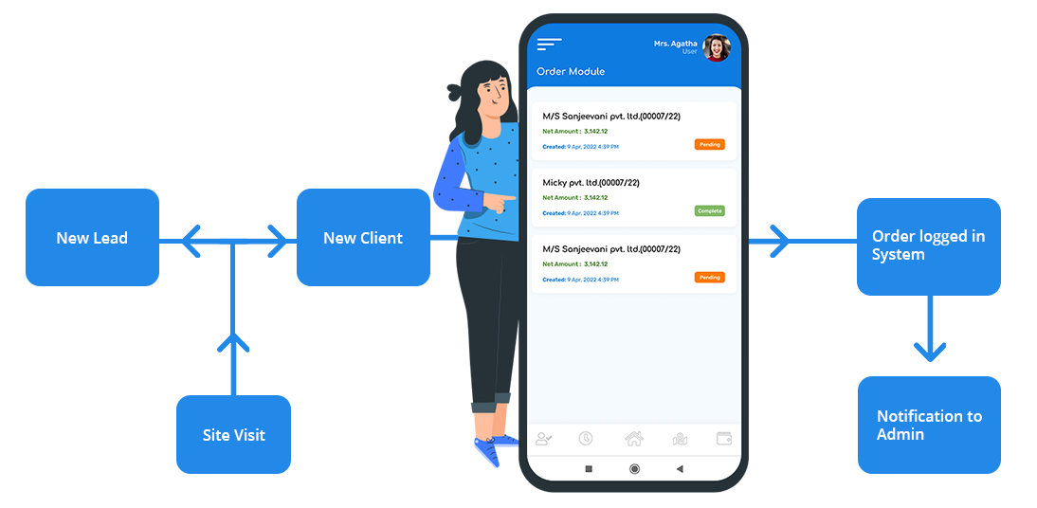
System Overview
What is mySalesCloud.in?
A comprehensive Sales Order Automation solution using an Android app, designed to streamline sales and distribution processes for businesses.
Android-Based
Real-Time Updates
Mobile-first approach for field sales teams
Instant inventory and order status tracking
Order Management
Payment Processing
Complete order lifecycle tracking
Secure payment confirmations
Business Benefits
Enhanced Efficiency
Reduced Delays
Improved Customer Service
Better Inventory Control

Slide 4
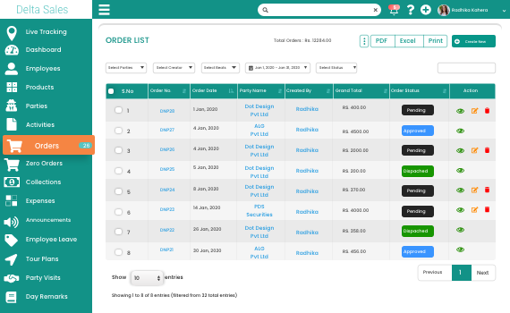
Key Features
Core Capabilities
Real-Time Inventory
Order Tracking
Live inventory tracking with automatic updates across all channels
Complete visibility of order status from placement to delivery
Payment Confirmations
Android App
Mobile-first solution for on-the-go sales teams
Additional Features
Secure payment processing with instant confirmations
Cloud Platform
Multi-User Access
Analytics Dashboard
Custom Reports

Slide 5
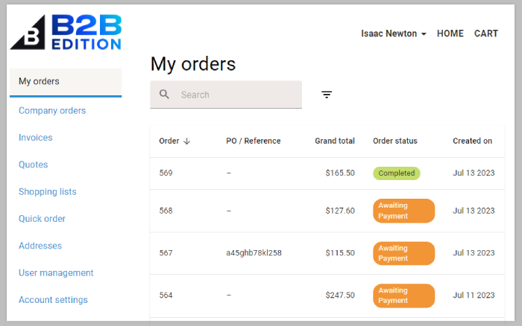
B2B and B2C Ordering Capabilities
Dual Ordering Models
B2B Ordering
B2C Ordering
Bulk ordering capabilities
Direct consumer sales
Custom pricing tiers
Shopping cart functionality
Credit management
Multiple payment options
Corporate account handling
Customer loyalty programs
Core Ordering Capabilities
Product Catalog Management
Order Processing
Customer Management
Pricing & Discounts

Slide 6
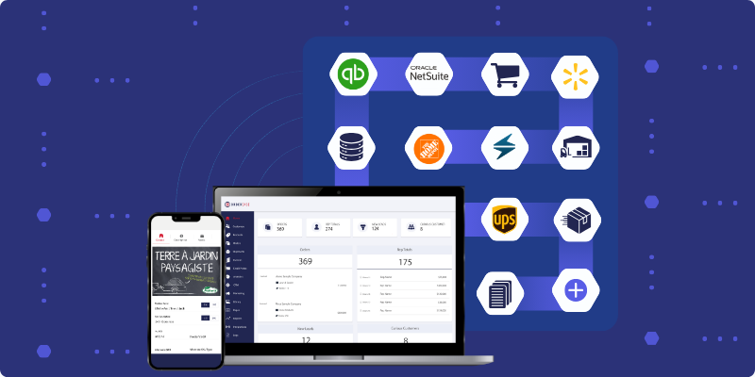
E-commerce Functionality
Online Shopping Capabilities
Online Storefront
Mobile Shopping
Complete e-commerce website with product catalog and shopping cart
Responsive design for seamless shopping across all devices
Payment Processing
Real-time Sync
Payment Gateway Integration
Secure payment gateway integration for multiple payment options
Automatic synchronization between online and physical inventory
PayPal Integration
Razorpay Support
Secure Transactions
Instant Confirmations

Slide 7
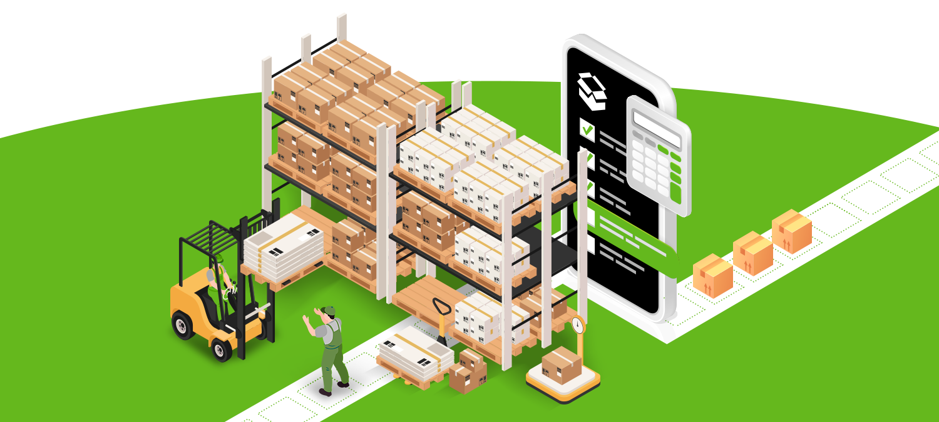
Inventory Management
Real-Time Inventory Control
Real-Time Updates
Instant inventory synchronization across all channels and locations
•
Centralized & Decentralized
Flexible inventory management for both centralized warehouses and decentralized stores
•
POS Integration
Seamless integration with Point of Sale systems for accurate stock tracking
Inventory Benefits
Stock Alerts
Order History
Batch Tracking
Analytics

Slide 8
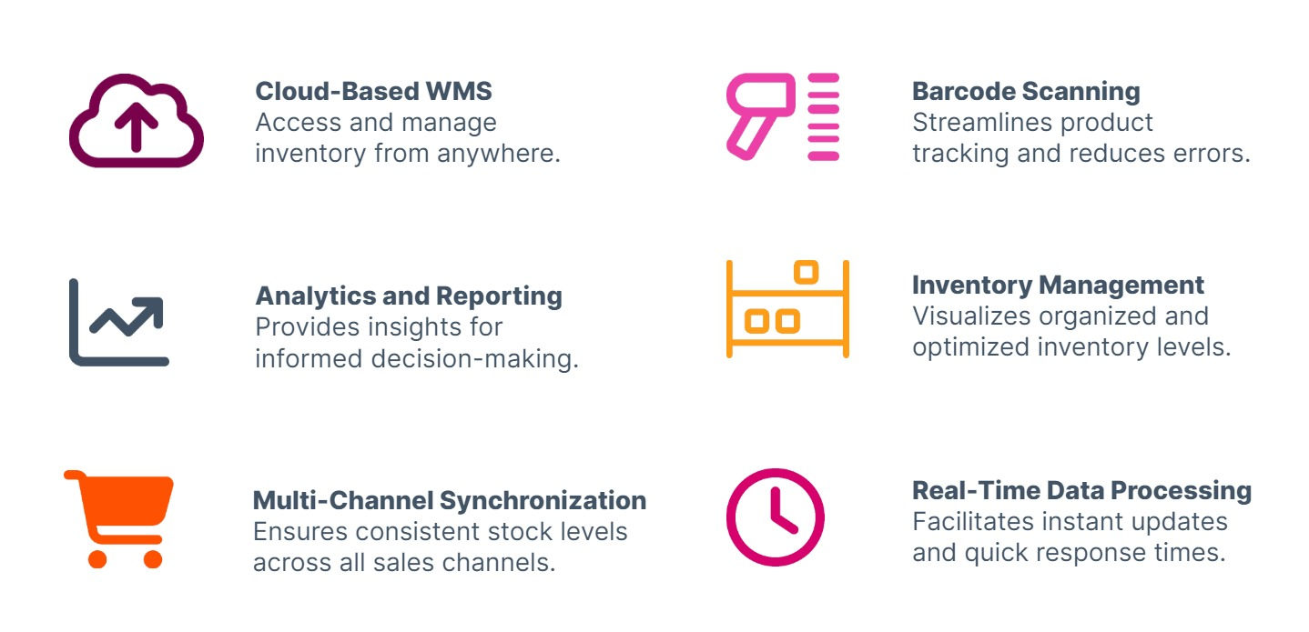
Benefits and Contact Information
Key Advantages
Enhanced Efficiency
Reduced Delays
Streamlined processes reduce manual work and increase productivity
Faster order processing and fulfillment with real-time updates
Contact Information
Improved Service
Cost Savings
A-801, Samudra Complex, Near Klassic Gold Hotel, Off C.G.Road, Ahmedabad, Gujarat, India
Better customer experience with accurate order tracking
Lower operational costs through automation and inventory optimization
info@bonrix.net
📞
+91-9426045500, 9429045500

