Slide 1

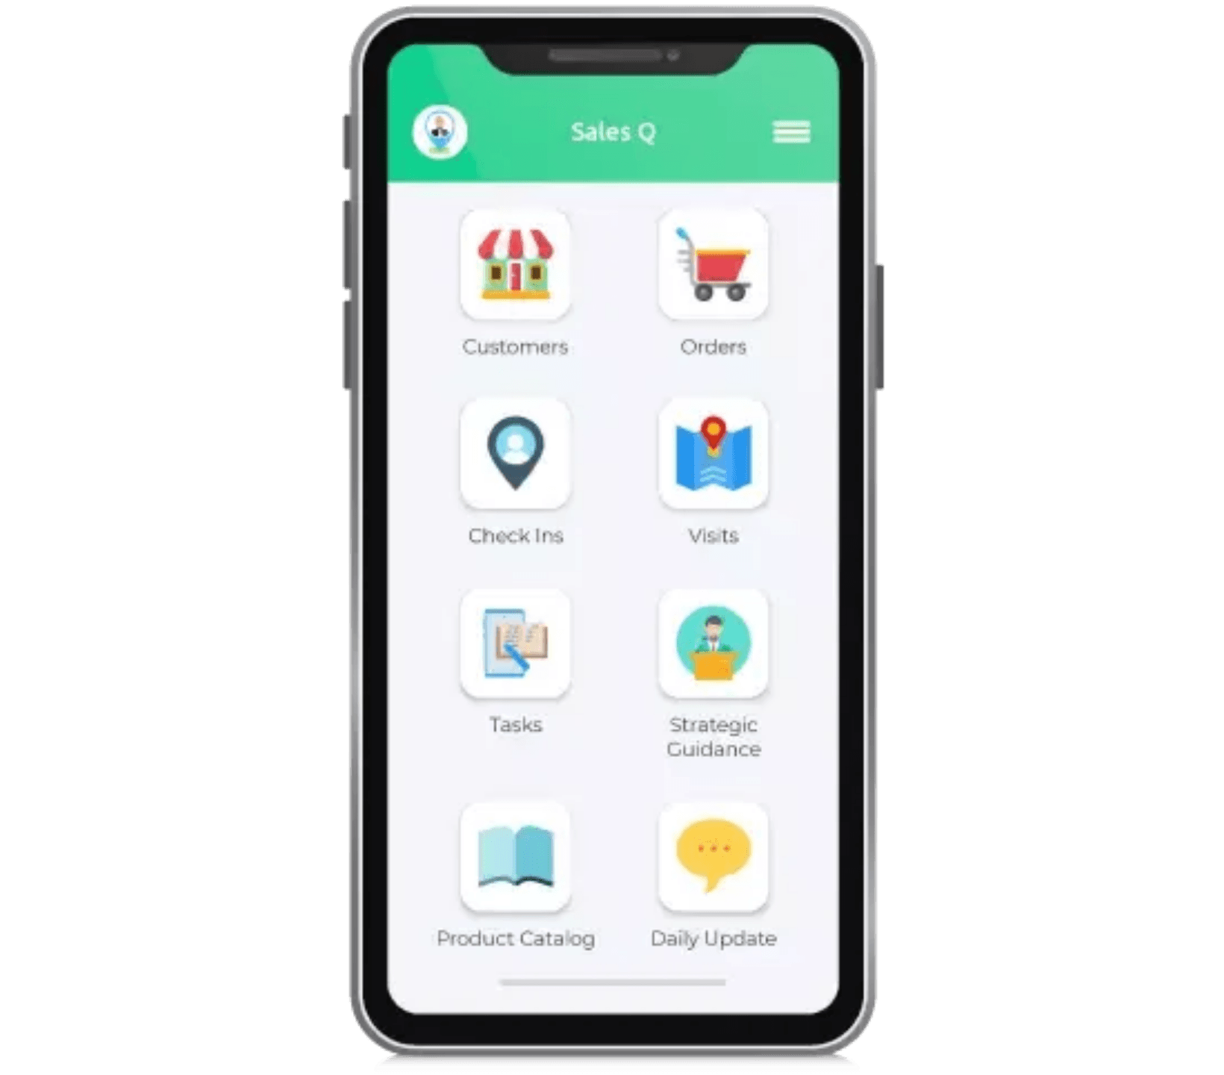
MySalesCloud
Cloud-Based
Sales Order Automation & Cloud POS
Empowering businesses with seamless, real-time sales order automation and cloud-based Point of Sale systems for comprehensive sales and retail management.

Slide 2

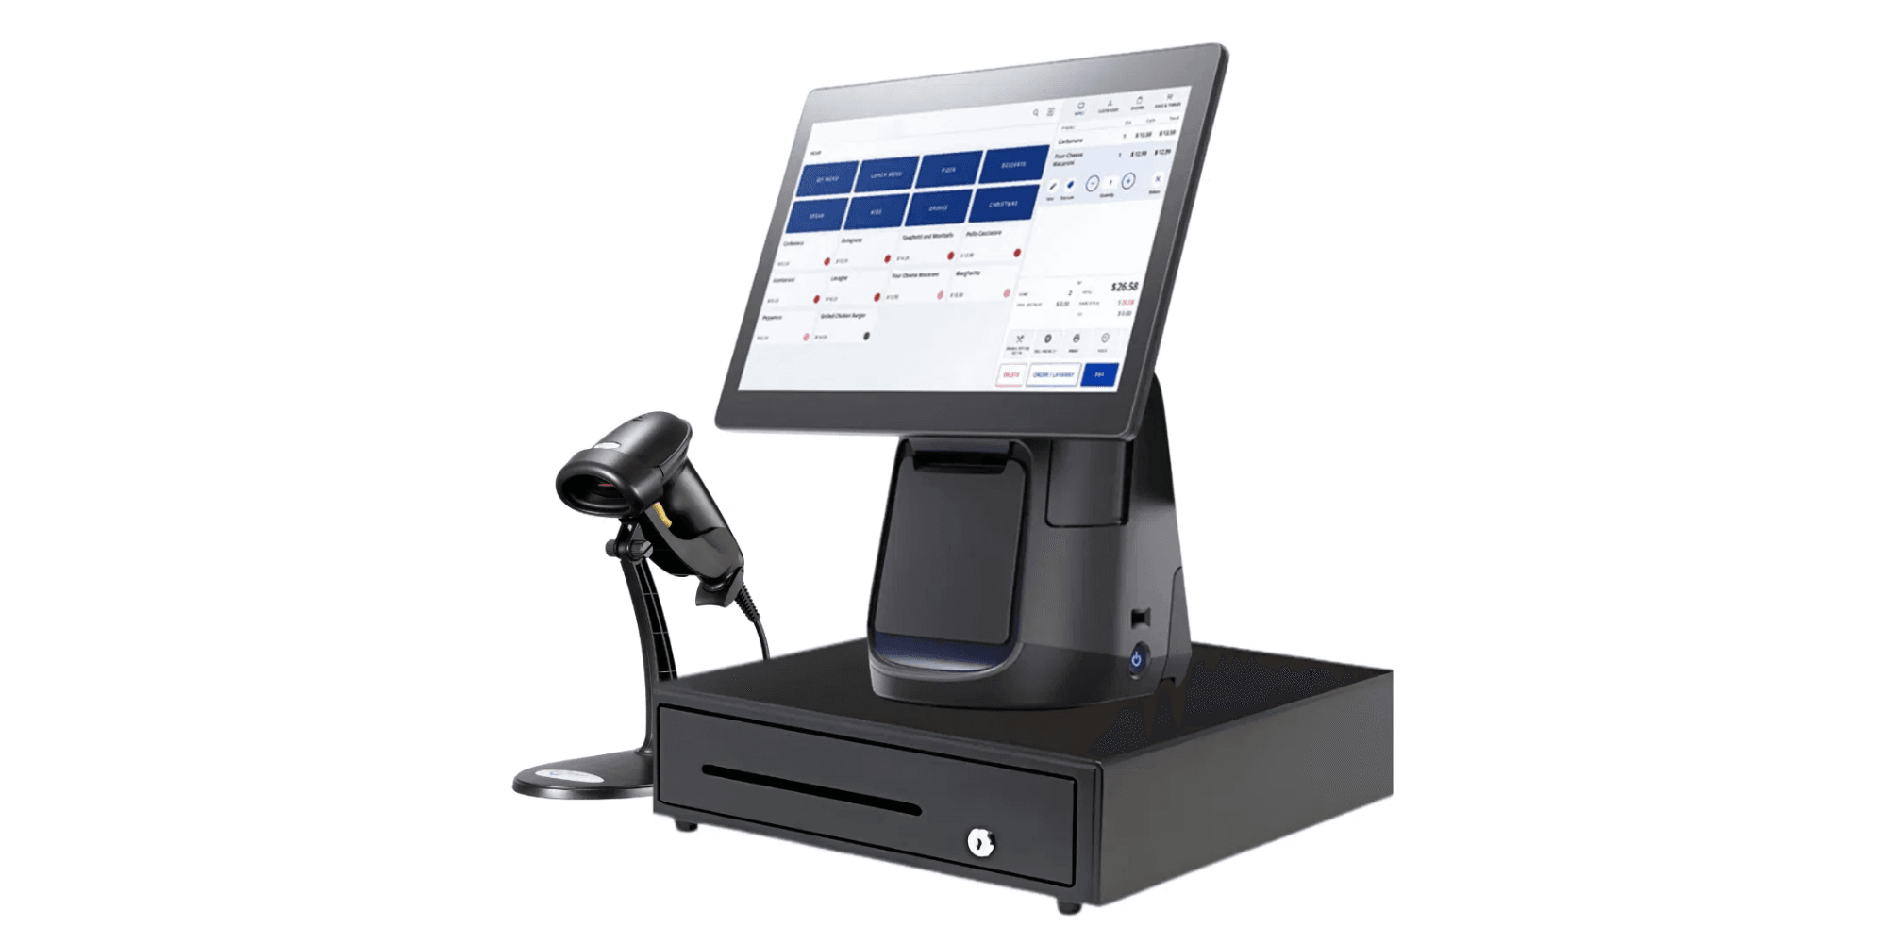
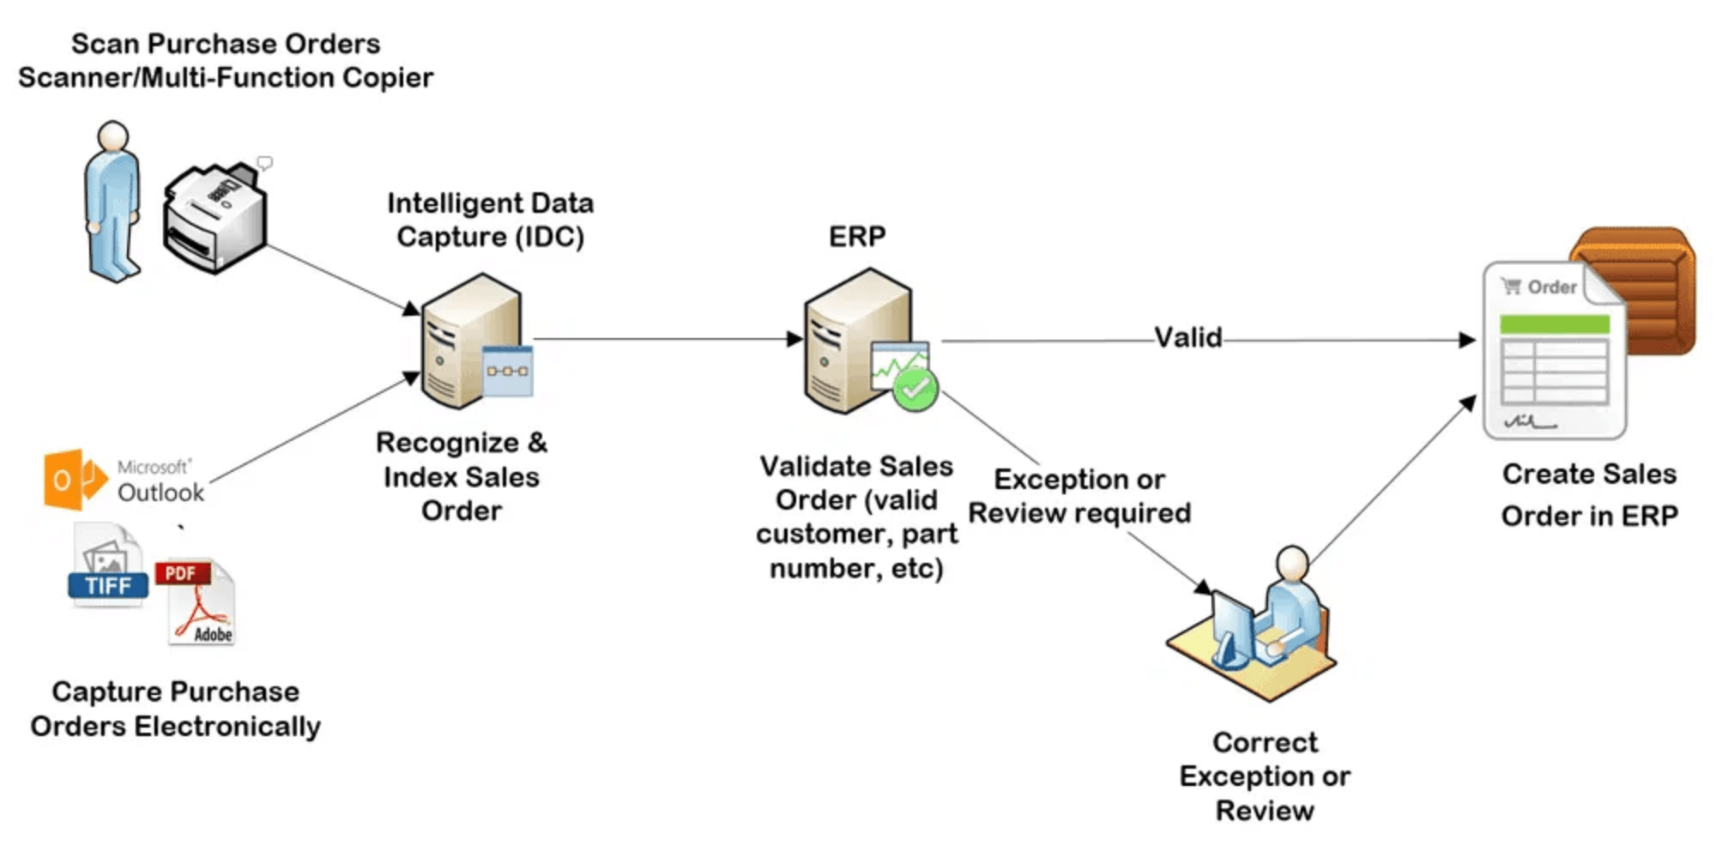
Core Offerings
Automation for the Sales Ecosystem
Sales Order Automation (FOS)
Mobile App
Android app-based solution for field staff to manage sales orders, tracking, and payments on the go.
Bonrix Cloud POS System
Cloud-based point-of-sale system for quick billing and real-time inventory management across multiple store locations.
Tailored B2B Ordering Platform
Specialized business-to-business ordering solutions customized for your specific enterprise needs.
POS Terminal
Online Food Ordering System
Restaurant menu-based App & Web solution for Table, Take Away, Pre-Order, and Home Delivery orders.

Slide 3

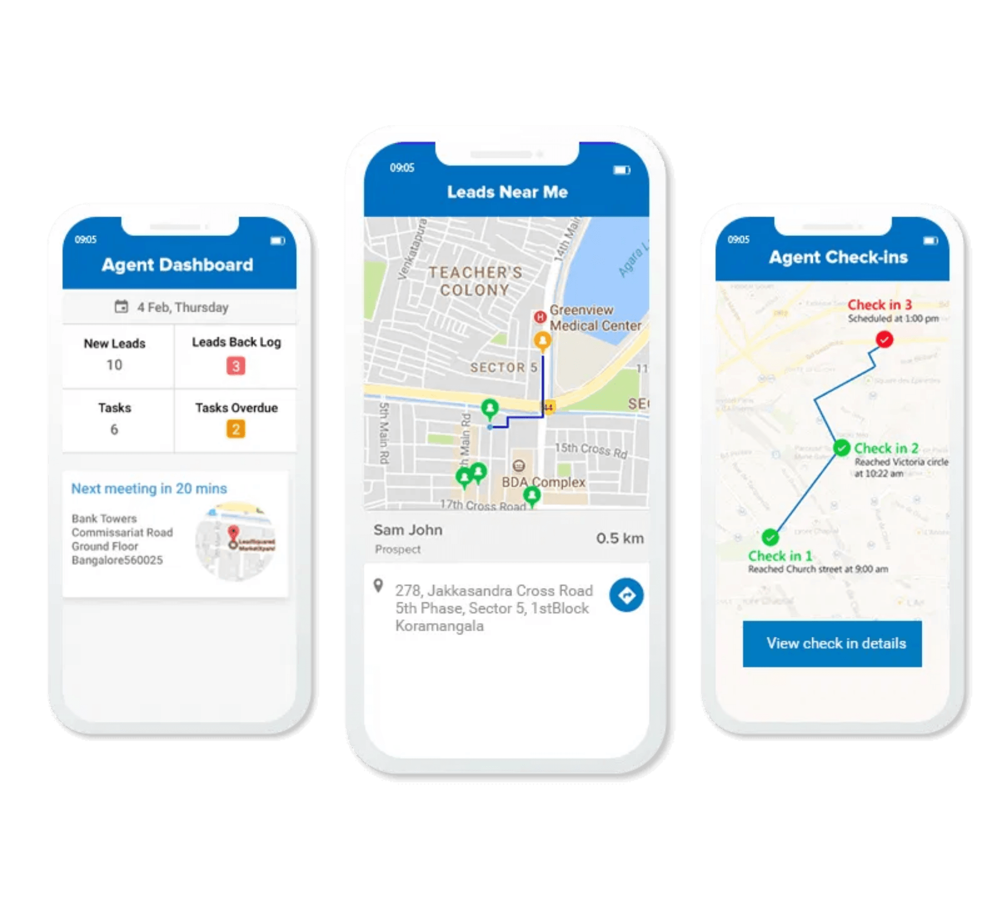
Key Features Driving Sales Efficiency
1
Real-Time Data Synchronization
Cloud-based architecture ensures immediate updates for inventory and sales across all user roles.
Benefit: Eliminates discrepancies and provides instant business intelligence.
2
Mobile-First Design
Dedicated Android application for Field Sales Staff (FOS) with full functionality.
Benefit: Maximizes on-the-go productivity and order capture efficiency.
3
Multi-Role Hierarchy
Granular access control for Admin, Company, Counter, Store, and Field Staff.
Benefit: Tailored functionality and secure operations for every level.
4
Seamless Billing & Inventory
Cloud POS designed for rapid transaction processing and centralized stock control.
Benefit: Faster checkout times and improved customer experience.

Slide 4

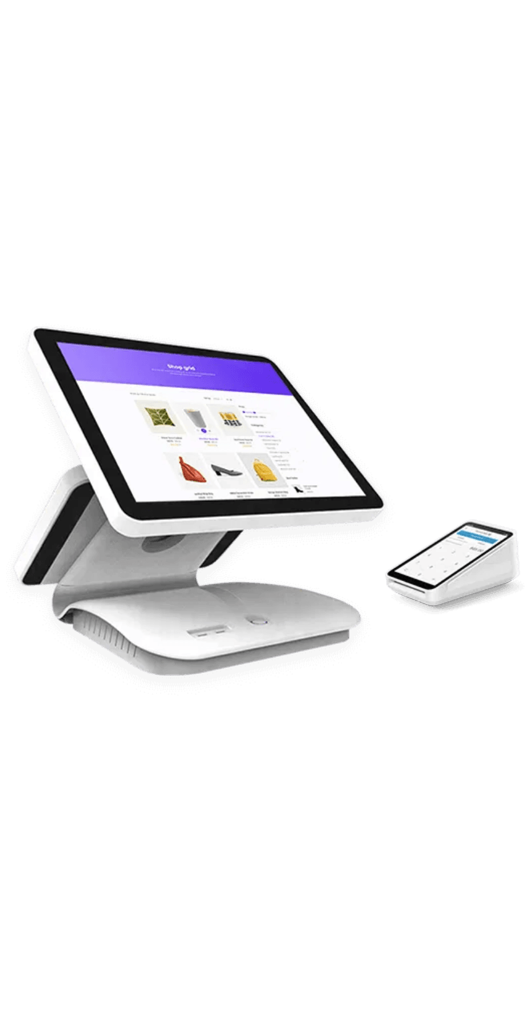
Practical Use Cases Across the Value Chain
📱
🛒
Field Sales Management
Retail Operations
FOS staff uses the Android app for order booking, payment collection, and customer visit tracking in real-time.
Store and Counter staff leverage the Cloud POS for fast billing, inventory checks, and multi-location management.
📦
🍽️
Distribution & Logistics
Hospitality Sector
Managers oversee purchase orders, item dispatch, and order approval, ensuring a smooth supply chain flow.
The Online Food Ordering System facilitates Table, Take Away, Pre-Order, and Home Delivery services.

Slide 5

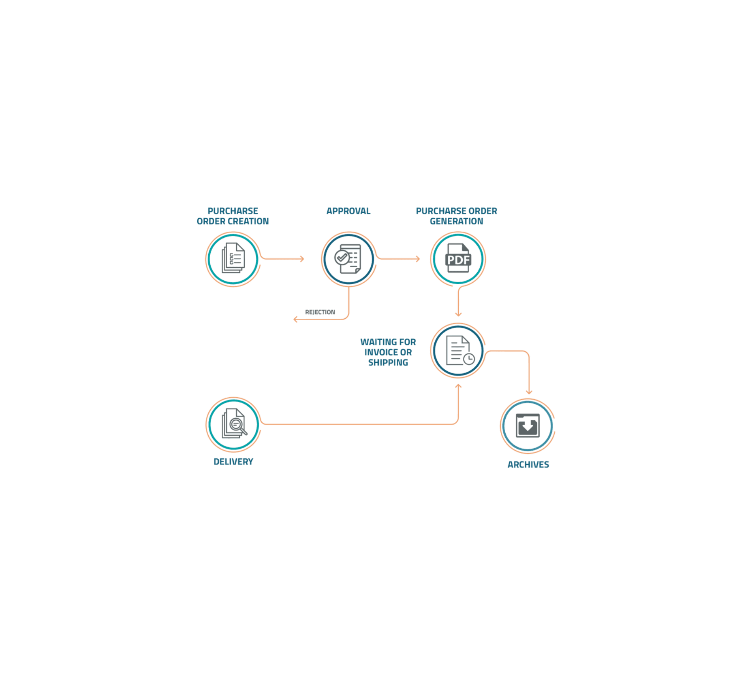
Strategic Focus: Innovation & Client-Centricity
💡
Latest Innovation
Latest Product Highlight
The
Bonrix Cloud POS System
showcases our shift towards modern,
cloud-based retail and sales solutions that empower businesses with real-
time control.
⚙️
Technology Foundation
Commitment to using the latest development technologies including
Android, Microsoft .NET, and J2ME
to deliver robust, scalable solutions.
🎯
Core Philosophy
The company's philosophy is to exchange
"Value"
focusing on
Satisfaction, Excellence, and Growth for every client partnership.

Slide 6

Transform Your Workflow with MySalesCloud
✓
Robust & Adaptable Solution
MySalesCloud provides a comprehensive, technologically advanced solution for end-to-end sales and retail automation.
✓
Quality & Long-Term Relationships
We focus on quality, tailored solutions, and building lasting working relationships with our clients.
✓
Real-Time Operational Control
Streamline your sales order process and achieve real-time visibility across your entire sales ecosystem.
Ready to revolutionize your sales operations?
Request a Demo Today

Slide 7

Bonrix Software Systems: The Company Behind MySalesCloud
Mission & Philosophy
Core Services
Contact Details
The core philosophy is the exchange of "Value," aiming to deliver customer satisfaction, continuous excellence, and growth.
MySalesCloud (Sales Order Automation & POS)
•
Company
Bulk SMS & Voice Call Solutions
Bonrix Software Systems
•
GPS Tracking & Vehicle Monitoring
•
Address
History
A-801, Samudra Complex, Near Klassic Gold Hotel, Off C.G.Road, Ahmedabad, Gujarat, India
GST Billing Software
•
Android & Web Applications
Bonrix Software Systems, a leading Group SMS Software provider in India, commenced operations in the year 2001.
•
Phone
CRM & Sales Management
•
+91 96246 45500 +91 94290 45500
E-commerce & Shopping Cart Solutions
Based in Ahmedabad, Gujarat, we've grown from a small startup to a trusted partner for businesses nationwide.
•
Custom Enterprise Software Development
E-Mail
•
info@bonrix.net bonrix@gmail.com
Website
https://mysalescloud.in

